Slide 1

FactorFlowers: Boquet Preview App
Spa Mahapiyasilp

Slide 2
Project overview
The product:
A bouquet preview app, offering real-time custom bouquet visualisation and end-to-end ordering.
Project duration:
Dec 2025 – Jul 2026 (estimated)

Slide 3
Project overview
The problem:
When buying a boquet, users are often unsure if certain flowers will look good together and if it will be appropriate for the occasion.
The goal:
Allow users a simple way to preview custom flower combinations and place an order, all in one app.

Slide 4
Project overview
My role:
Lead UX/UI designer
Responsibilities:
Responsible for all stages of the design thinking framework, from empathising to defining, ideating, prototyping and testing.

Slide 5
User research
Personas
Problem statements
User journey maps
Understanding
the user

Slide 6
User research: summary
The app is positioned as a customer‑facing e‑commerce experience, designed for end users rather than florist staff. While no real users were interviewed for this project, realistic personas were developed based on research into common buyer types for bouquets. Moreover, a competitive audit was conducted to understand how similar apps approach the customer journey.

Slide 7
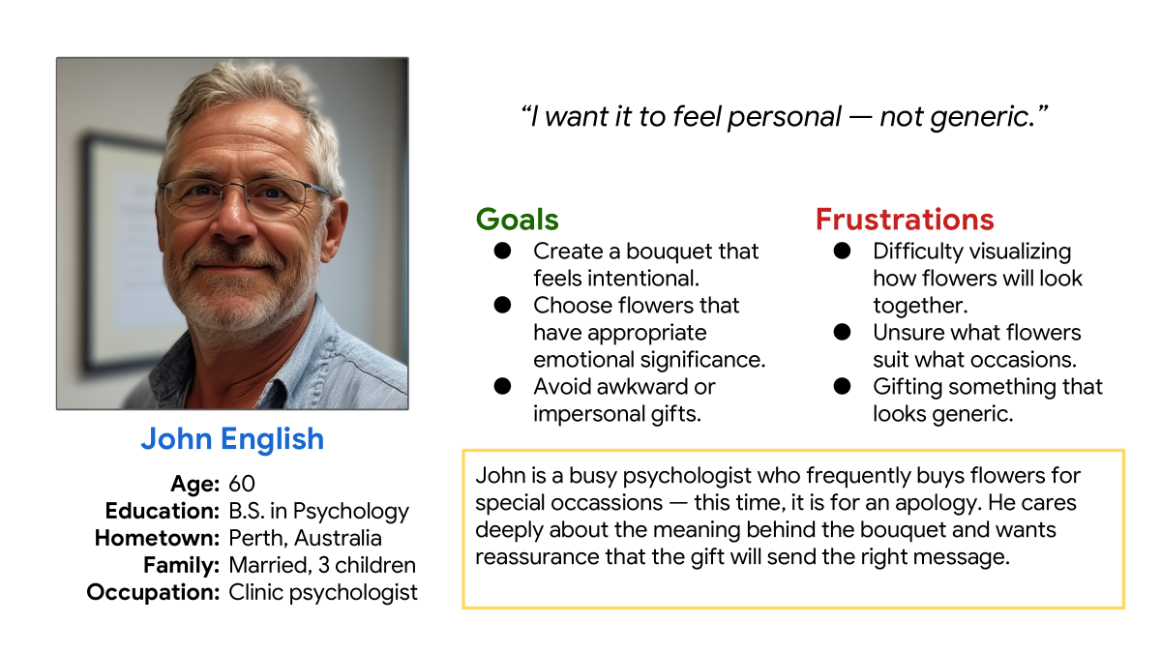
Persona: John English
Problem statement:
John English is a thoughtful gifter who needs a simple way to create an intentional bouquet because he wants his gift to feel appropriate for the occasion.

Slide 8
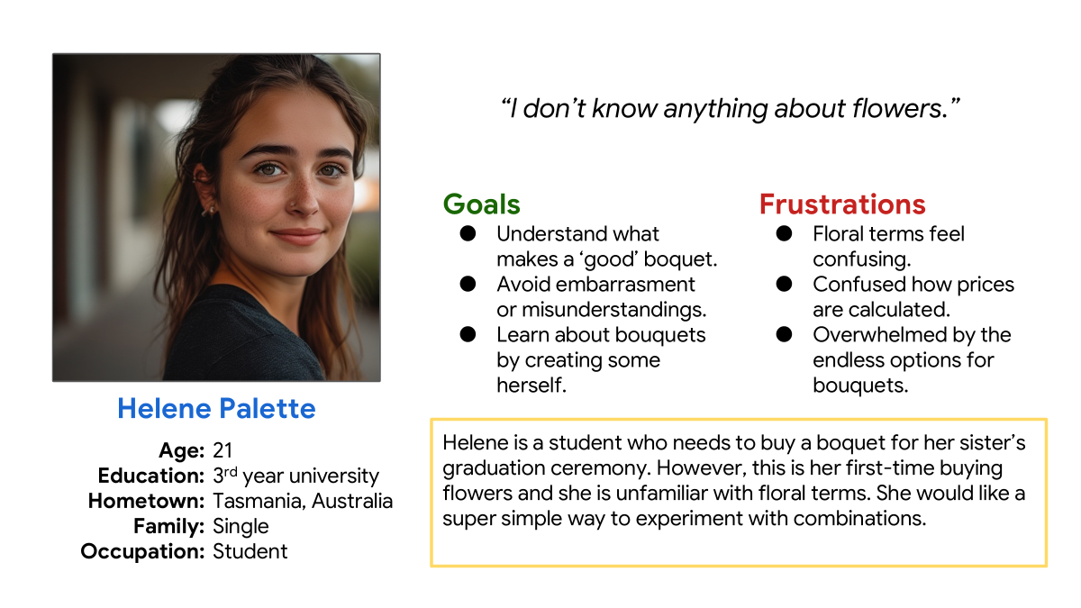
Persona: Helene Palette
Problem statement:
Helene Palette is a first-time flower buyer who needs an easy way to play with floral combinations because unfamiliar terms and pricing make the process feel overwhelming.

Slide 9
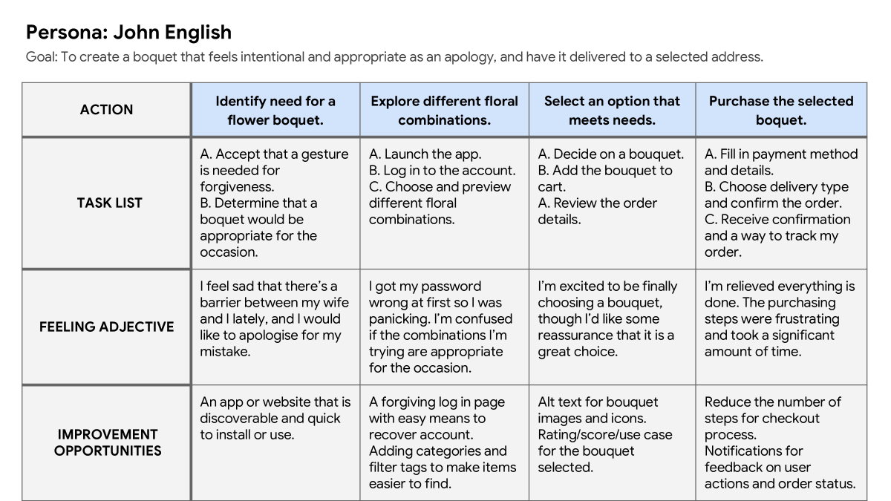
User journey map
John will first need to determine a need to buy a bouquet, then explore and select one that meets his needs through the app and finally purchase it.
Image of user journey map

Slide 10
Competitive audit
Competitive audit | Compare the bouquet viewing experience of each competitor's app.
Notes | 1. At the time of this audit, no direct competitors were identified that offered both bouquet previewing and end-to-end ordering. As such, this audit focuses on indirect competitors, either with static images or no ordering features. 2. This audit focuses slightly more on the mobile app experience than the desktop website experience.
 | General information |  |  |  |  |  |  |  | UX (rated: needs work, okay, good, or outstanding)
 |  |  |  |  |  |  |  |  | First impressions |  | Interaction |  |  |  | Visual design | Content
 | Competitor type (direct or indirect) | Location(s) | Product offering | Price ($ - $$$$) | App name | Business size (small, medium, large) | Target audience | Unique value proposition | Desktop website experience | App or mobile website experience | Features | Accessibility | User flow | Navigation | Brand identity | Tone | Descriptiveness
My Global Flowers Delivery | Indirect | International | Send flowers and gifts online to multiple cities and countries | $$ | My Global Flowers Delivery https://myglobalflowers.com/ | Large | Individuals who need flowers sent across different countries | Reliably send flowers and gifts across the globe through one platform | Good + Strong brand color - Feels dense in places | Outstanding + Pleasing on the eye | Okay + Ability to favorite items and view composition - Checkout page feels too dense - No reviews or ratings | Good + 5 different languages offered + Alt text for images - Delivery prices and dimensions are lacking contrast with background | Outstanding + Just a few clicks to checkout | Okay + Easy to use search bar - Overwhelming number of groups in information architecture. 'Plants' group is empty | Good + Strong color scheme and art direction - Inconsistent use of photography | Serious and creative | Good + All key info is present - Too descriptive (e.g., including dimensions in the card) - No price promotions
FlowerStore.ph | Indirect | Philippines | Send bouquets and gifts for any occasion | $ | FlowerStore.ph https://flowerstore.ph/ | Medium | Local customers in the philippines looking for affordable bouquets | Affordable, occasion-based bouquets for a local audience | Outstanding + Consistent layout for products | Good + Easy navigation for categories - Feels a bit dense with content - Cards have differing heights, leaving a gap | Good + Can read reviews from other users - No delivery price listed in product page - No favorite feature | Good + Strong visual hierarchy + Alt text for images - No settings for customisation of font size, color, or language | Okay + Fast sign up process for new users - Asking users to select a date and time on product page, which is strange | Outstanding + Easy to scan and search by catogories | Okay + Clear font and art direction - Inconsistent color scheme between pages | Friendly and direct | Good + All key info is present - Unnecessary delivery details
Flower Architect | Indirect | USA | Create virtual flower arragements and display in virtual scenes | $$$ | Flower Architect https://www.flowerarchitect.com/en | Small | Floral professionals who need software to visualise bouquets | Advanced tools for experimenting and visualising flower arrangements | Okay + Simple to use - Looks more like a game than a software | Needs Work - Lengthy and fustrating sign up process - Visuals look immature | Oustanding + Select, arrange, store, and edit spaces. | Okay + 20+ languages supported - Small font sizes makes content difficult to read - Confusing icons (e.g., for logout or redirecting to online website) | Outstanding + Clear flow from selecting flowers to arranging them to organising them in folders | Needs Work - Extremely slow loading between pages - Always need to come back to home page to go to a different page | Okay + Clear color scheme (blue and pink) - Weak brand identity - Color contrast is weak | Serious and direct | Needs Work - Not enough info in home page - Icons lack labels - Baskets are too descriptive (e.g., including code such as WKD4Y3)
Pinterest | Indirect | International | Plan aesthetics, including florals, or view aesthetics made by other users | $ | Pinterest https://www.pinterest.com/ | Large | Users seeking visual inspiration and ideas | Connect users with ideas and inspirations for aesthetics | Outstanding + Clean, simple design | Outstanding + Helpful color tags for filtering + Consistent between desktop and mobile | Outstanding + Personalised suggestions + Create your own idea or explore others's | Outstanding + Descriptive alt text - Multiple languages offered | Outstanding + Simple to go from searching to saving or downloading ideas | Outstanding + Personalised categories + View search history | Good + Dark and light themes - Mobile experience does not have the logo | Friendly and personalised | Okay + Short and to the point - Section titles are too repetitive - Lack of standardisation in descriptions
View full competitive audit here.

